Slide 1


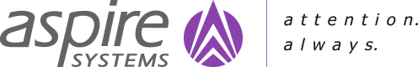
JHA- Security Presentation

Slide 2
Agenda
1
Security Operations Support
2
Performance Management
3
DevSecOps

Slide 3
Security Operations
Notes:
Press CTRL and grab the side border to resize the title box without decentering it.

Slide 4
SOC Support Offerings for an USA-based Insurance Provider
Customer:
Business Model:
Revenue :
Our customer offers a broad array of protection products through multiple brands and diverse distribution channels, including auto, home, life, and other insurance offered through its different brands. This customer offers more than 113 million proprietary policies across USA.
B2B Enterprise Software ISV
USD 4 Billion and above
Challenges
Large volume of False positive alerts
Lack of SIEM best practices and SOC Design
24x7 Security Operations Support
Delay in responding and remediating to threats
Non- Compliance to PCI-DSS

Slide 5
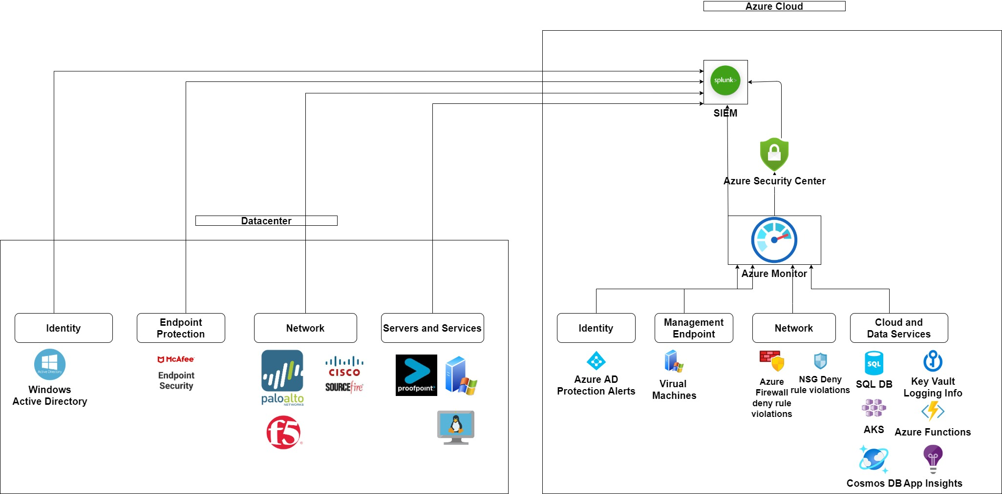
SOC Architecture

Slide 6
Key Threats and Remediation
Threats | Remediation's | Source logs
Login attempts to Azure Subscriptions from unauthorized ip address range | 1.Request to remove the sources created in unapproved region 2.Isolate malicious or infected resource from accessing other resources 3.request to rotate the affected keys and reprovision affected resources. | Azure AD
VM key pairs changes detected - Modification of VM Key pairs in Azure | 1.Suspend user access 2.Increase Privilege Restrictions | Azure VM Instances.
Unapproved region - Azure activity Azure Instances created in un-approved azure regions | 1.Isolate malicious or infected resource from accessing other resources 3.Request to rotate the affected keys and reprovision affected resources. | Azure Activity log
Azure policy deny action Deleted | 1.Suspend user access 2.Increase Privilege Restrictions | Azure Activity logs
Potential SQL Brute Force attempt | Block the IP address | Azure Defender
Azure ATP-Suspected netlogin privilege esclation | 1.Network Containment 2.Internet Access containment 3.Proxy block of URL/domain 4.Firewall url IP/block | Azure AD
Suspected golden ticket usage (encryption downgrade) procedures - Golden ticket is the Kerberos authentication token for the KRBTGT account. | 1.Network Containment 2.Internet Access containment 3.Proxy block of URL/domain 4.Firewall url IP/block | Azure AD
A logon from a malicious IP has been detected | Block the IP address | Azure Monitor Log Analysis
Detected ransomware indicators | Terminate the server | Azure Defender
Container with a sensitive volume mount detected (AKS_SensitiveMount) | Unmount the volume and prevent it from mounting again | Azure Monitor Audit Log
SSH server is running inside a container (VM_ContainerSSH) | Stop the container | Machine logs indicate that an SSH server is running inside a Docker container. While this behavior can be intentional, it frequently indicates that a container is misconfigured or breached.

Slide 7
Key Availability and Security Metrics
Services | Metric
Kubernetes | capacity_cpu_cores
Kubernetes | node_cpu_usage_percentage
SQL Databases | active_queries
SQL Databases | app_cpu_percent
SQL Databases | app_memory_percent
SQL Databases | blocked_by_firewall
Application Gateways | HealthyHostCount
Application Gateways | Throughput
Application Gateways | AvgRequestCountPerHealthyHost
Application Gateways | BackendResponseStatus
Application Gateways | BlockedCount
Application Gateways | BlockedReqCount

Slide 8
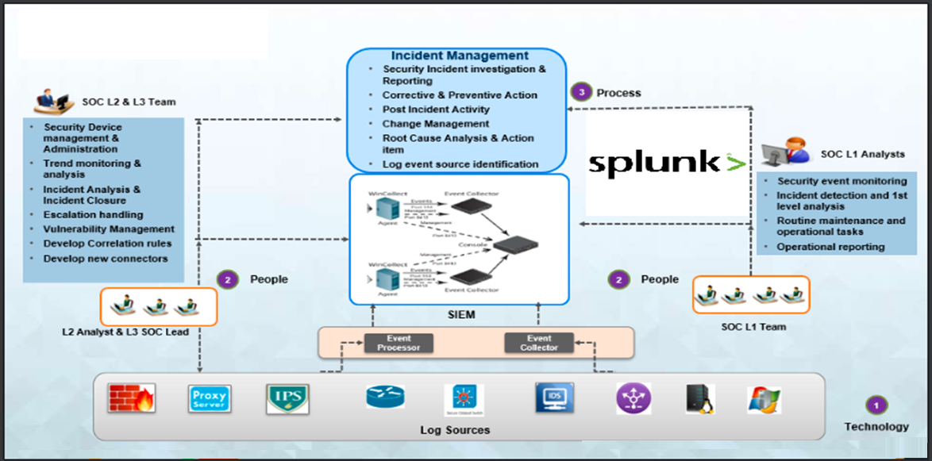
SOC Workflow
SOC Workflow

Slide 9
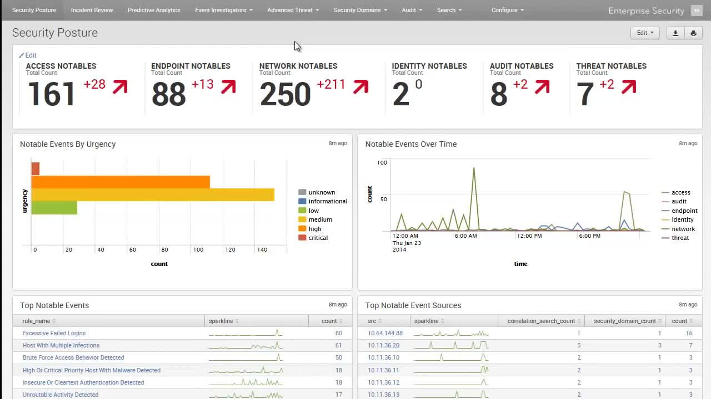
SOC Dashboards

Slide 10
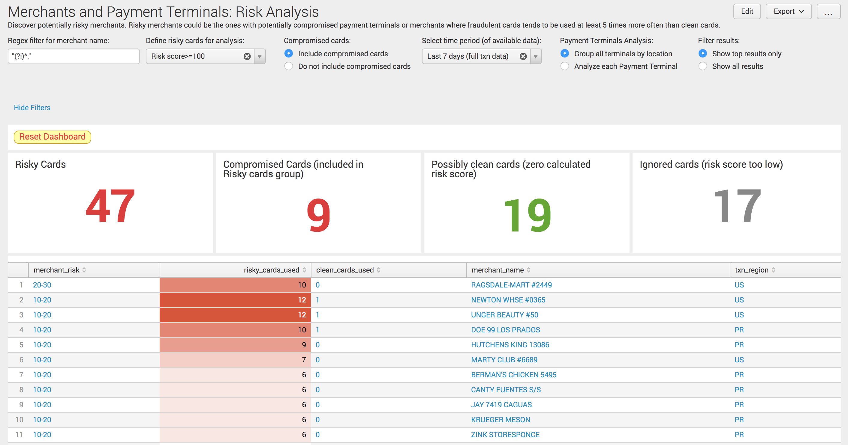
SOC Dashboards

Slide 11
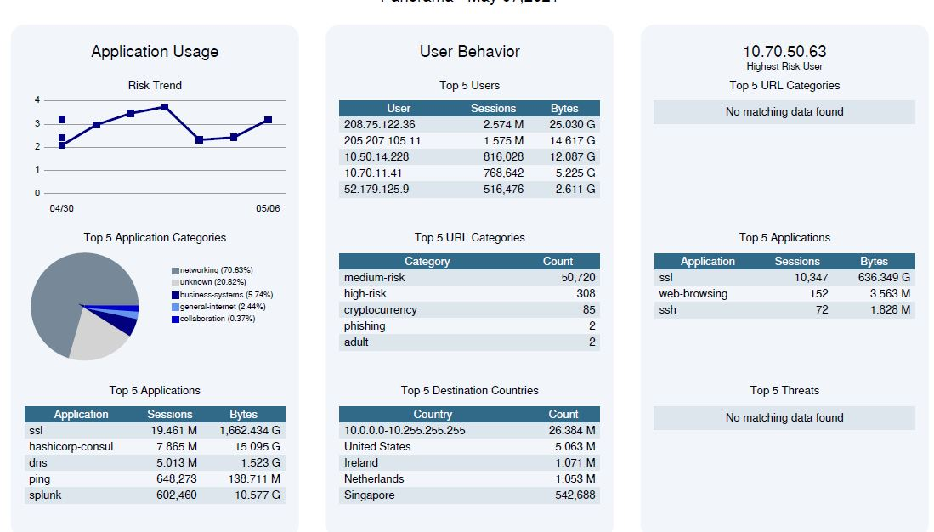
SOC Dashboards

Slide 12
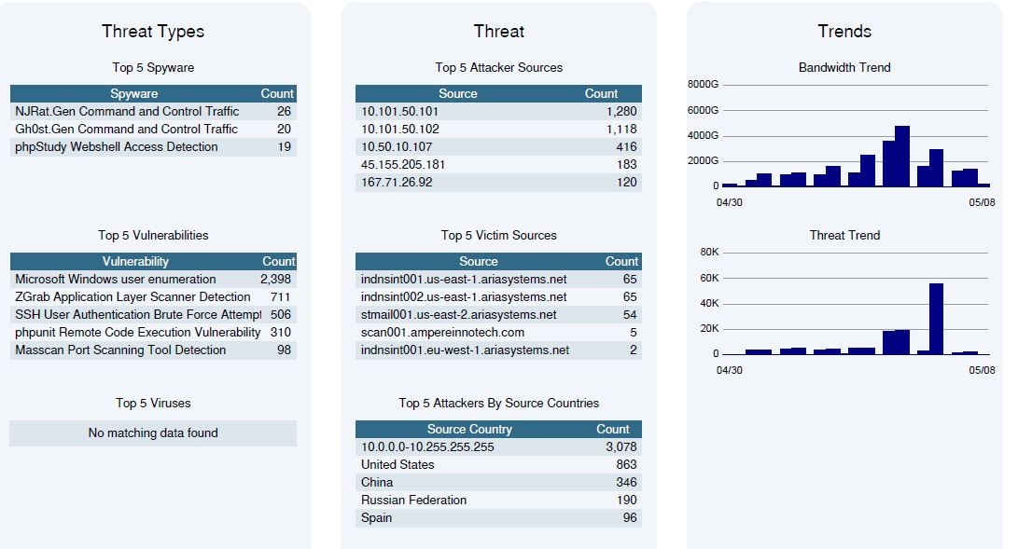
SOC Dashboards

Slide 13
Security Support for a banking Customer
Customer:
Business Model:
Revenue :
The NBK was founded in 1952. It is the largest financial institution in Kuwait, with branches and subsidiaries in China, Geneva, London, Paris, New York, and Singapore, and a regional presence across the Middle East in Lebanon, Jordan, Egypt, Bahrain, Saudi Arabia, Iraq, Turkey, and the UAE
Banking and Financial Services
USD 32 Million and above
Challenges
The part of the digital banking initiative the Bank was looking to build new Digital Banking Application.
Aspire was designated to setup the Azure infrastructure with the security compliances recommended by the bank
Build the CI/CD pipeline for the digital banking application within a short timeline of 3 months.

Slide 14
Tools and Technologies
Tool Name | Purpose | Resources/Services
Azure Sentinel | SIEM | All Azure Security events
Azure Defender | Threat protection and Endpoint solution | Azure VM, Key Vault, Storage account and Azure SQL
Azure Security Center | Threat Detection | All Azure sources
Azure Policy | Security compliance policy | All Azure resources
Azure Threat Protection | Threat protection | All Azure resources
Azure Intune | Data protection | Mobile devices
Azure Monitoring | Monitoring | All Azure resources
Palo Alto | VPN | Network resources
Azure conditional Access | Security access restriction | Azure portal and 3rd party apps
Qualys | Vulnerability Assessment | Azure VM

Slide 15
Technical Highlights and Benefits
Built Azure Security complaint to the following Azure Security Benchmark, ISO 27001,PCI DSS 3.2.1,SOC TSP
Azure Sentinel implemented for centralized SIEM activity
Achieved 99% in Azure security center score
Azure AD SSO, MCAS security solution implemented for 3rd party applications​
Implemented Intune for device security​
O365 security compliances implemented working along Bank GISO​ team
Implemented Next-Gen Palo-alto ​

Slide 16
SOC Support Offering for a USA Based Billing Solution Provider
Customer:
Business Model:
Revenue :
Our customer offers cloud-based monetization platform removes billing bottlenecks to allow companies to quickly launch and evolve their offerings
Billing Solution Provider (ISV)
USD 30 Million and above
Challenges
No centralized monitoring for security operations.
Rules and policies were defined in each individual security tools like firewall, endpoint security, Proxy, email gateway etc.
Handle / track the immense volume of alerts triggered in each individual tools.
Issues in complaints to various Security standards.
Striving to defend sensitive data of the customer, enforce compliance and to prevent security breaches / attacks
Needed a team to implement SIEM and other tools and leveraging machine learning and advanced analytics.

Slide 17
Tools and Technology
Technology | Tools
SIEM | LogRhythm and Splunk(log retention)
Endpoint | ESET
Vulnerability Management | Trustwave
Firewall | PaloAlto
Ticketing Tool | JIRA

Slide 18
Benefits
Handing more than 2000+ incidents per month
Identified the false positive alerts and fine-tuned the rules and reduced it to 3%
Helped to concentrate more on real events and to understand the pattern
30-40% decrease of security incidents & resources
False Positive alerts were tweaked, and the percentage came down to 3%

Slide 19
Performance Monitoring
Notes:
Press CTRL and grab the side border to resize the title box without decentering it.

Slide 20






Tools Expertise

Slide 21
Performance Metrics: Back-End
Response Time
Latency
Throughput
Hits Per Sec
Connect Time
Error %
Sent/Received KB/Sec
Elapsed time from just before sending the request to just after the last response has been received
Time between just before sending the request to just after the first response has been received
Number of requests processed per unit of time by server and is calculated from start till the end of the test execution
Number of requests that hits the server per second
Time it took to establish the connection, including SSL handshake
Percentage of requests that resulted in error
Represents the network throughout in Kilobytes/Sec

Slide 22
Performance Metrics: Real Browsers
User Centric Metrics
Navigation Events
Time to First Byte
Amount of time a browser waits to receive the first piece of information from a web server after requesting it
Redirect
Measure in total the amount of time redirects took for a page load
First Paint
Time of the first point at which the browser does any sort of rendering on the page
App Cache
Time of resource loading from the browser cache rather than being retrieved from the network
First Contentful Paint
Time when the browser renders the first piece of DOM content
DNS Lookup Time
Time elapsed performing the DNS lookup, that is, requesting the IP address for a certain domain name
DOM Interactive Time
Time it takes for enough page elements to load for an end user to begin interacting with the page
TCP
Time taken to establish the transport connection as well as other time intervals such as SSL handshakes. If HTTPS, this process includes TLS negotiation time
DOM Content Loaded
Time until the document has loaded, and the initial markup has been parsed, no CSS is blocking scripts, and that parser blocking JavaScript(s) have executed
Request
Time elapsed between making an HTTP request to the server, relevant application caches, or from local resources and receiving the first byte of the response
DOM Complete
Response
Time elapsed between the first byte and the last byte of the response received or immediately before the transport connection is closed, whichever comes first
Time until the page and all its sub resources are ready
On-Load Time
Time when the page has finished processing and all the resources on the page, including text, images, CSS and JavaScript files, have finished downloading
Processing
Time taken to render the page(processing the data by parsing and requesting additional sub resources requested by the documents)
Fully Loaded
On-Load
Time when the browser finishes loading its document and resources. The page is considered fully loaded when it triggers a `load` event
Total time it took to fully load the page

Slide 23
DevSecOps
Notes:
Press CTRL and grab the side border to resize the title box without decentering it.

Slide 24
DevSecOps Security Controls
PROD
Application Protection
Infrastructure and Data Protection
Rinse and Repeat
3
Protect and monitor the app and cluster using RASP/WAF and container sand-boxing
Apply infrastructure hardening, data encryption endpoint protection, DLP and IPS
7
Improve and enforce governance
4
Vulnerability Scanning
Ensure continuous assessment and automated OS benchmarking of build and deployed images and environments
Privileged access, secrets management & network isolation
5
2
Implement tight network & access policy by looking down clusters/pods, VM's
Use secrets management and automated certificate handling
Continuous monitoring & Incident Response
6
Analyze intrusion/breach alerts and threat intelligence log attacks, behaviors and threats to respond, learn from and apply to next sprint
Deploy to Production
1
Automated Deployments by IaC compliance and security testing
SECURITY

Slide 25
Tools
Privileged access, secrets management & network isolation
Application, Infrastructure and Data Protection
Azure Application Gateway WAF
Azure KeyVault
JIT Access
AKS Azure RBAC
Hashicorp Vault
Azure Firewall
Azure Policy
ASE
Cloudflare WAF & DDoSProtection
Jscrambler
Hdiv
Vulnerability Scanning
Azure Defender
Qualys
Continuous monitoring & Incident Response
Azure Monitor
Azure Security Center
Azure Sentinel
Nessus
Rapid7

Slide 26
Measures
Privileged access, secrets management & network isolation
Application, Infrastructure and Data Protection
Protection from a variety of risks including OWASP’s top 10 vulnerabilities, injections etc.. using necessary rules in web application firewalls
Clear seggregation of DMZ
Vulnerability Scanning
Regular checks and validations of CIS benchmarks for the servers and images
Continuous monitoring & Incident Response
logging and monitoring for all computes, network endpoints and services
POLP for the users and roles to login the servers
POLP for service access
Vault or secrets manager to store secrets
Periodic Secrets Rotation
Centralized Authentication Control
Organization level security governance policies
"Deny All" as default policy
Mandatory Encryption for disk, drives and any storages
IDS and IPS enabled firewall with audit for access violations
End-to-end encryption for any application transactions
Monitoring and Threat Detection model customized to the need
Prioritized Alerts and Telemetry
central log management
centralized alert correlation platform and create an incident based on them
Intelligent Threat Correlation
Automated Response
CIS benchmark certified images for any production deployments
appropriate compliance policy configuration (GDPR, PCI, NIST)

Slide 27
DevSecOps Security Controls
Development
1
Secure by Design
Security Tests
Secure Code Training
2
Gather threat and abuse case models and security requirements. Adapt reusable secure by-default design patterns
DAST perform app specific automated security testing and dynamic container analysis. Validate controls are mitigating the abuse case threat sectors
Engineers gain awareness of AppSec principles and responsibilities
CI Server deploys to Test
7
8
Automated deployment via IaC
Pre-commit configurations for secret scanning Secure access to app, code & Image repository
3
Composition Analysis
Security Review (Human Logic Test)
Implement least privilege RBAC and new solution to code and private container repository IaC version controlled
6
Analyze third party/open source libraries. Reuse secure code only and comply with OSS licensing
9
Conduct penetration testing where it makes sense.( Might not be needed for every sprint)
SPRINT
Secure Access to CI Service
Code Analysis
Image Assurance
4
Prevent unauthorized manipulation of the pipeline itself with RBAC and separation of duties
5
SAST analysis code for vulnerabilities IDE and build server integrated with remediation advice
10
Validate image integrity signatures and that assurance polices are yet to proceed to prod
Automated
Sign off
SECURITY

Slide 28
Tools
Secure Code Training & Designing
OWASP
Pre-commit Security Hooks
Secure access to CI service
Code Analysis and SCA
SANS CWE
12 Factor App Guidelines
Secure Access to Code and Image repository
Git-hound
Detect-secrets
Git-Secrets
Repo-supervisor
IDE Security Plugins
DevSkim
FindSecurityBugs
Sonar Lint
In-built Credentials Manager
Centralized Secret Manager
Grssecurity
SAST
Veracode
Fortify
SCA
OWASP dependency-check
Coverty
NetSparker
Composition analysis
OWASP dependency-check
Coverty
MicroFocus Fortify,SonarQube,Veracode
NetSparker
Black duck Biany Analysis
Terraform
ARM templates
Deploys to Test
Security Test DAST
DAST
Veracode
Fortify
IAST
Image Assurance
Anchore
Clair
Burpsuite
Metasploit
NMAP
Nessus
Salamp
Wireshark

Slide 29
Measures
Secure Access to Code and Image repository
Secure access to CI service
Code Analysis and SCA
SCA Automation
Composition analysis
test environment isolation from production subscription
Deploys to Test
Image Assurance
certify OS images for vulnerability using vulnerability data feeds
Multifactor Git Authentication
Integration with SSO
Fine grained Repository Role Based Access Control
Automated Secrets/config scanning
JIT access to cloud resources
SSH keys and Personal Access Tokens Rotation
pre-commit security hooks integration
Integration with organization Active Directory / Enable Single Sign on
POLP for user RBAC
fine-grained permissions for build pipelines tasks
CI environment hardening
Automated CI Patch management
unsafe environment variable values Filtering
fine-grained permissions control on Agents
OWASP Dependency-Check plugin for publishing results
SCA Automation
OWASP Dependency-Check plugin for publishing results
Strict perimeter security
Identical to Prod Setup
POLP for RBAC
Secret Filtering in IaC
State files Isolation, encryption and versioning
Hardened images meeting requirements of CIS benchmarks
Static analyze for non-OS data using National Vulnerability Database (NVD) which includes RPM, Deb, APK, PIP, Ruby Gems etc.,
Image Scanning using anti-virus

Slide 30

Thank You

Slide 31
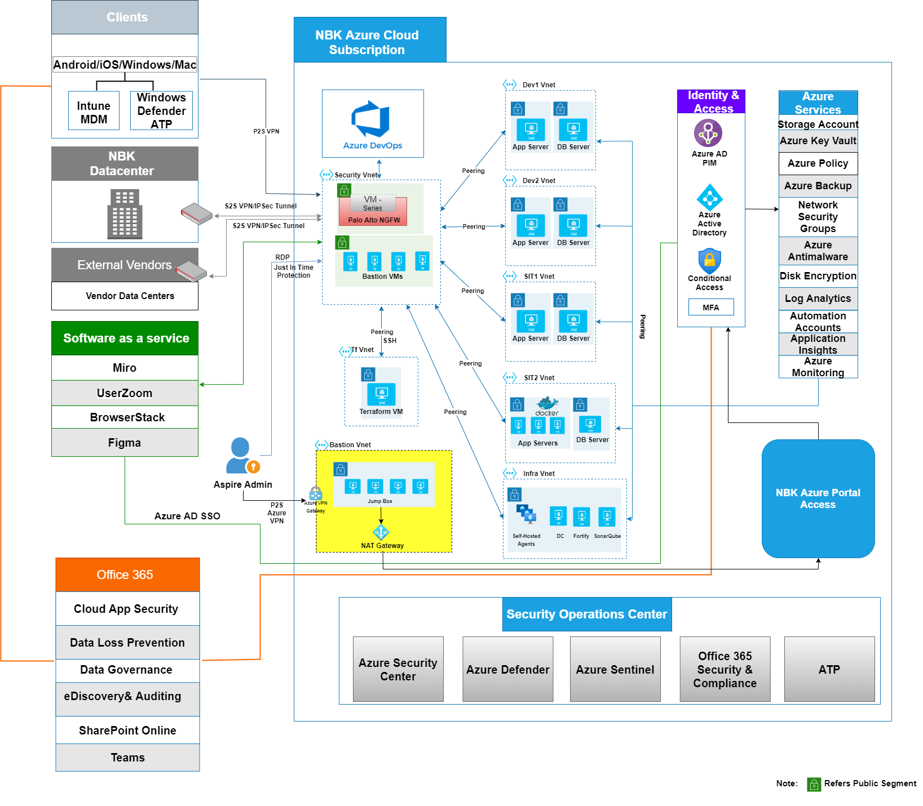
NBK Case study – Solution diagram

